Slide 1
SISC Small Group Kickoff
AIRA

Slide 2
SISC Small Work Groups
Tightly scoped to a specific topic
Time limited, the group meets for four weeks
Interest is driven by community
Three or more organizations/interests, including IIS
A champion willing to spearhead effort
All group members committed to provide specific help to group
Proposed guidance is brought back to SISC for discussion

Slide 3
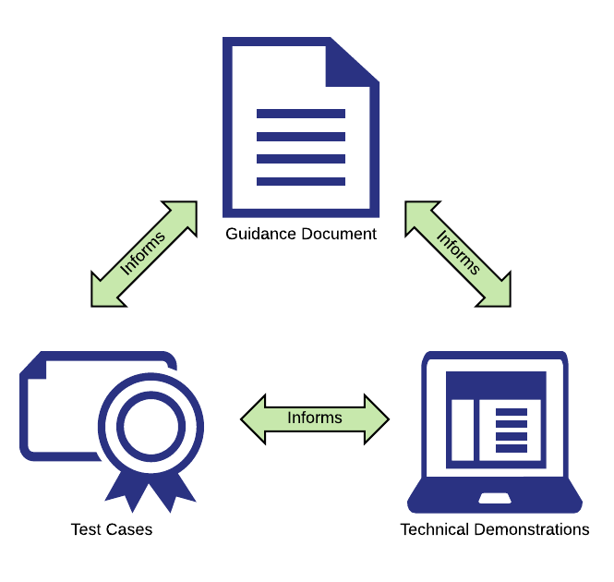
What will be created?
Guidance document
Specific technical guidance
Proposal only, SISC will review
Test cases
Testable scenarios that verify adherence to guidance
Technical demonstrations
Prove workability of guidance
Provide reference implementation

Slide 4
Project Intensity
Project Setup
Orientation and Discussion
Work Together
Work Finalized

Slide 5
Virtual Meeting
25 hour period where the entire group meets
From the afternoon until morning of the next day
Allows for team to operate on different timezones
Team needs to be committed to removing conflicting meetings
Bring group together in the afternoon of the first day
Split into smaller working groups to focus on deliverables
Come back together as needed
Bring group back together at the end on the second day
Show accomplishments, determine status of deliverables

Slide 6
Project Progression
Week 1: Project Setup
Group is formed, first Meeting, schedule set
Week 2: Orientation and Discussion
All information gathered, initial ideas shared, scope set
Week 3: Work Together
Virtual meeting
Week 4: Finalize Work
Prepare for SISC presentation

Slide 7
Group Tools
GitHub
Project board & task tracking
Wiki page with team resources and information
File sharing
Slack
Uber Conference

Slide 8

Setting Scope
Technical work group
Not policy work group
We can’t say what ought to be or what will be
Technical Toolbox
Prepare for different scenarios
Need guidance that can be implemented quickly

Slide 9
User Stories
Start with user stories
We don’t know how this might be used in the future
But we need to think about how we imagine it being used
Paint a picture
What does “done” look like?
Conditions of satisfaction

Slide 10
Thank You!

Slide 11
Additional Slides

Slide 12
Week 0: AIRA Prepares
AIRA setups tools:
GitHub, Slack, Uber Conference
AIRA identifies and pulls together preliminary group
Champion
Members

Slide 13
Week 1: Project Setup
Tasks for small group champion
Propose meeting schedule
Begin collection of relevant resources and information
Create project wiki
Create proposal for scope and deliverables
Begin creating tasks needed to meet deliverables
Meet with group members and determine what they will contribute
Obtain commitments for specific deliverables
Obtain commitments to clear calendar for “working day”
Organize into smaller teams focused on Guidance, Tests, or Software

Slide 14
Week 2: Orientation and Discussion
Meet with small group
Introductions
Frame problem to be solved
Review background material and work already completed
Request proposals for possible solutions
Allow time for review and response
Try for short but regular touch points
Come to agreement on which solution(s) will be defined
Finalize tasks and deliverables, assign to group members

Slide 15
Week 3: Work Together
Members will begin work separately
Come together for one “virtual day”
All members should be “out-of-office”, committed to this project
Meet all together on the same virtual line
Try to complete all tasks on this day

Slide 16
Week 4: Work Finalized
All tasks that will be completed are moved to “Done”
Final version of proposed guidance is released
Final version of test cases are released
As appropriate: software is available, or committed, or deployed
Wiki page is updated with the latest information
Presentation of work accomplished is given to SISC

